Slide 1
Joint alignment,
question by question
STUDY NOTES · THE JOINT MODEL
The questions you asked while working through the paper, in the order you asked them. Each answer goes intuition first, then a picture, then the maths.
Every answer was checked against the paper and the code. Where the chat got something wrong, the slide says so, and two slides at the end collect the corrections.
Notes:
Built from your question-and-answer session about the joint alignment paper. Numbers come from the paper (main.tex) and the code (src/multibatch.py). Slides tagged Intuition use the cream background; slides tagged Maths use the blue-grey background.

Slide 2
Fourteen questions, in the order you asked them
YOUR QUESTIONS
1 Why does every route between batches give the same map?
8 What does “positive definite” mean?
2 Why does fitting never need an inverse?
9 What is the gauge, and does the choice matter?
3 What is a piecewise-linear hat basis?
10 How does robust reweighting (IRLS) work?
4 Basis weights or knot parameters: which is the warp?
11 Is IRLS like Adam?
5 Why store increments instead of knot values?
12 Why can’t ordinary cross-validation pick the smoothness?
6 What does min ‖Aθ − y‖² subject to bounds say?
13 What do the band and the interval tell us, and why 81%?
7 Is the loss “strictly convex”?
14 How does one batch borrow strength from the others?
Each slide’s eyebrow gives the question number and whether it is the intuition or the maths.
Notes:
Question 11 (is IRLS like Adam?) was a follow-up to question 10, and question 13 merges two related questions you asked about the uncertainty section.

Slide 3
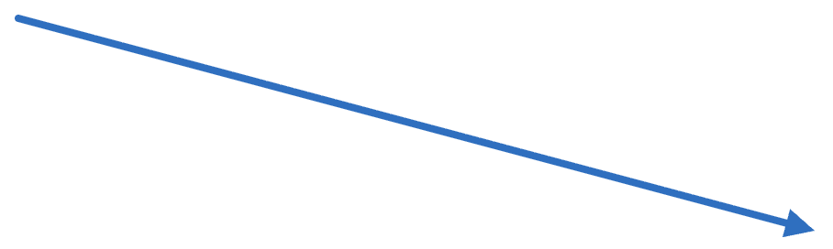


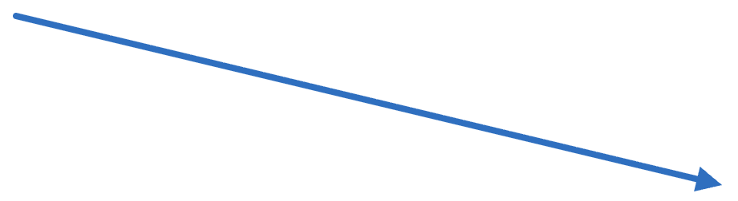
A detour steps off the clock and back on
Q1 · INTUITION
Batch k
Batch m
fₖ
fₘ⁻¹
fₘ
shared clock
τ = fₖ(t)
fₗ⁻¹
Batch l
Pairwise fitting gives every pair its own map from its own anchors: 10 maps for 5 batches. Nothing forces k → m → l to agree with k → l.
The joint model gives each batch one warp onto a shared clock. Going via m means stepping off at τ and back on at the same τ, so the detour changes nothing.
You asked: how does “transitivity by construction” hold for any two paths between batches?
Notes:
The shared clock is the latent retention-time axis. Every batch k has one monotone warp f_k from its own retention time onto that axis. A map between batches is always “go onto the clock with the first batch’s warp, come off with the second batch’s inverse warp.” Blue: the direct route from k to l. Orange: the detour through m, which leaves the clock at τ and returns to the very same τ. The next slide writes this as algebra.

Slide 4
Every path telescopes to the same map
Q1 · MATHS
Define the map from batch k to batch l as gₖ→ₗ = fₗ⁻¹ ∘ fₖ: on with fₖ, off with fₗ⁻¹. Then for any m:
gₘ→ₗ ∘ gₖ→ₘ = fₗ⁻¹ ∘ (fₘ ∘ fₘ⁻¹) ∘ fₖ = fₗ⁻¹ ∘ fₖ = gₖ→ₗ
Any longer path k → p₁ → p₂ → l: every inner pair cancels to the identity.
fₗ⁻¹
fₚ₂ ∘ fₚ₂⁻¹ = id
fₚ₁ ∘ fₚ₁⁻¹ = id
fₖ
= gₖ→ₗ
On the fish data
Consistent is not correct
Composed pairwise maps miss the direct map by 0.116 min on average over 60 ordered triplets, and by up to 0.277 min, more than one bin. Joint model: at most 0.0023 min, from inverting on a grid.
The cancelling only needs each fₖ to have an inverse; the slope bounds guarantee that. If an fₖ is wrong, every map through it is wrong in the same way.
Paper Eq. (1) and the transitivity figure. Function composition is associative, which is what lets the brackets move.
Notes:
Read composition right to left: f_k acts first. The proof uses only two facts: composition is associative, and f composed with its own inverse is the identity on the shared clock. Neither depends on the data, which is why the property holds “by construction.” The 0.0023 min is numerical: the code inverts each warp by linear interpolation on a grid of 4T points, so the maps cancel up to that interpolation error.

Slide 5
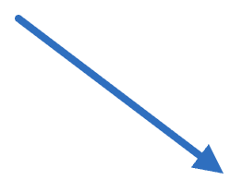
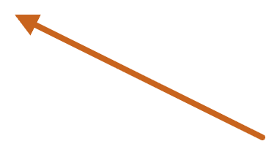
Fitting only ever warps forward
Q2 · INTUITION
Batch k
a = 50
fₖ
Shared clock
fₖ(a) = 52, fₗ(b) = 53
fₗ
Batch l
b = 56
miss r = fₖ(a) − fₗ(b) = 52 − 53 = −1 bin
While fitting
After fitting
Both peaks go forward onto the clock and we score the gap. No inverse, so each miss stays linear in the unknowns.
To move a whole chromatogram from k to l we need gₖ→ₗ = fₗ⁻¹ ∘ fₖ. The inverse is computed once, by interpolation.
You said: “We only care about the residual … not their warps back (the inverse) to another batch’s clock.” Correct. Toy numbers: dₖ(50) = +2, dₗ(56) = −3.
Notes:
An anchor is a pair of peaks, a in batch k and b in batch l, judged to be the same compound. A perfect fit would land both on the same point of the shared clock. The miss is measured on the clock, where both peaks arrive by their own forward warps, so the inverse never appears in the objective. The code computes each inverse after the fit by evaluating f_k on a grid of 4T = 800 points and swapping the axes with linear interpolation.

Slide 6
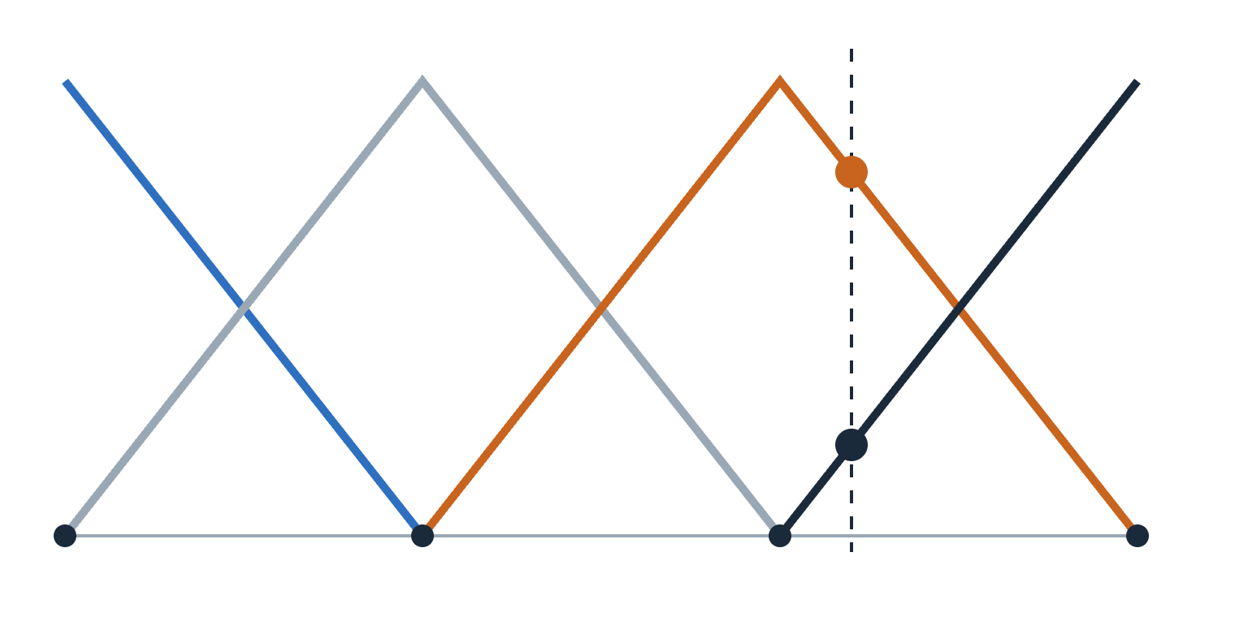
Each knot wears a hat; the two nearest share t
Q3 · INTUITION AND MATHS
For t between a left and a right knot, Δu apart:
left knot: (right − t) / Δu
right knot: (t − left) / Δu
They add to 1. Stack all the hats’ heights at t into a row: B(t). At most two entries are non-zero, and exactly one when t sits on a knot.
Knots 0–3 at t = 0, 10, 20, 30. Each hat is 1 on its own knot and 0 at its neighbours. Dashed: t = 22 meets knot 2’s hat at 0.8 and knot 3’s at 0.2.
B(22) = (0, 0, 0.8, 0.2)
Your summary (“at most two knots, or one knot if we are directly over a knot”) is exactly right. The model uses Q = 41 knots, about 1.1 min apart.
Notes:
At t = 22, the left knot is 20 and the right knot is 30, with spacing 10. Left weight (30 − 22)/10 = 0.8; right weight (22 − 20)/10 = 0.2. The nearer knot gets the larger weight. Because B(t) is computed from t and the fixed knot grid alone, it is a row of known numbers before any fitting happens. In the code this is _hat_basis(t, knots).

Slide 7
The warp needs both: weights times values
Q4 · MATHS
FIXED · GEOMETRY
LEARNED · DATA
Basis weights B(t)
Knot values Lθₖ
How close is t to each knot? Known from t and the knot grid before fitting. Never learned.
How much has batch k drifted at each knot? These are what the solver fits, one set per batch.
B(22) = (0, 0, 0.8, 0.2)
·
Lθₖ = (0, 2, 1, 3)
= 0.8·1 + 0.2·3 = 1.4 = dₖ(22)
The dot product is the drift at t, and the warp adds t back: fₖ(t) = t + B(t) L θₖ. The knot values say what the drift is; the weights say how to read it between knots.
You asked: is the warp stored in the weights, the parameters, or the product of both? The product. And yes, B(t) is the row of basis weights.
Notes:
θ_k holds the increments (c, δ₁, δ₂, …); multiplying by L turns them into the knot values. With θ_k = (0, 2, −1, 2), L θ_k = (0, 2, 1, 3). The chat’s worked example used drift in minutes; this toy uses bins. Neither piece alone is the warp: θ_k only knows the knots, and B(t) knows nothing about the batch.

Slide 8
One anchor becomes one row of a big matrix
Q4 · MATHS, CONTINUED
fₖ(a) = a + B(a) L θₖ
fₗ(b) = b + B(b) L θₗ
r = fₖ(a) − fₗ(b) = (a − b) + B(a) L θₖ − B(b) L θₗ
The row for this anchor, across all five batches’ parameters (41 columns each):
0 … 0
+B(a)L (batch k)
0 … 0
−B(b)L (batch l)
0 … 0
With target y = b − a, each miss is r = (row · θ) − y. The orange term is a known number and the blue term is linear in θ, so stacking every anchor gives r = Aθ − y: on the fish data, 25,011 rows by 205 columns.
You wrote “a − b + B(a)Lθₖ − B(b)Lθ…”: correct, with θₗ at the end. Paper Eq. (3); code builds A as X with y = tb − ta.
Notes:
The row has non-zero entries only in the two blocks of the batches the anchor connects. Every other batch’s block is zero, because that anchor says nothing about those batches directly. 205 columns = 5 batches times 41 knots. The order of the five blocks on the slide is illustrative; k and l can be any two different batches.

Slide 9
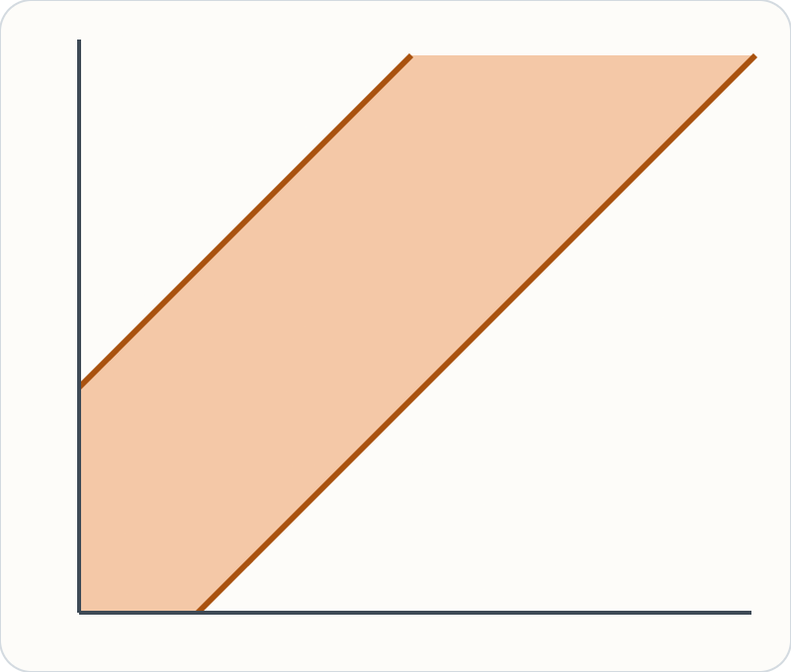
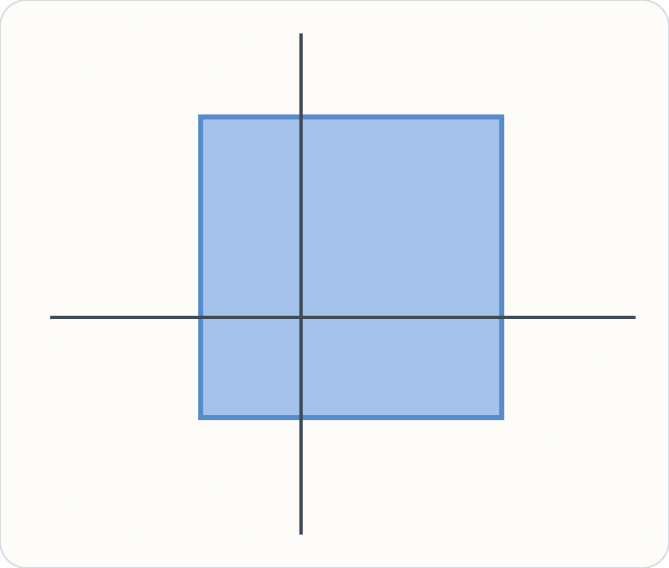
Increments turn the slope rule into a box
Q5 · INTUITION AND MATHS
θₖ = (c, δ₁, δ₂, …): the drift at the first knot, then the step to each next knot. L adds the steps up: Lθₖ = knot values.
The warp’s slope between knots is 1 + δ/Δu. Keeping it in [0.5, 2]:
−0.5·Δu ≤ δ ≤ 1.0·Δu
With Δu ≈ 4.98 bins: each step lies in [−2.49, 4.98] bins. The first entry, c, has no bound.
Knot values v_q, v_q+1: the rule ties neighbours together, a slanted band.
Increments δ_q, δ_q+1: each has its own interval, a box.
A box needs only lower and upper bounds per unknown, which bounded-variable least squares handles directly. A band would need a general constrained solver.
You asked: is L just a convenient way to sum the increments? Yes, and that choice is what makes the bounds simple. Paper Eq. (2); Δu = 199/40 bins.
Notes:
Δu is the knot spacing: 41 knots spread over bins 0 to 199 gives 199/40 ≈ 4.98 bins, or about 1.12 min at 0.225 min per bin. The slope bound [0.5, 2] means the warp can run at between half and double the speed of the shared clock, never stopping or reversing, so every warp is strictly increasing and has an inverse. The bound on δ is the slope bound rearranged: 0.5 ≤ 1 + δ/Δu gives δ ≥ −0.5Δu, and 1 + δ/Δu ≤ 2 gives δ ≤ Δu. The raw-value version is still a convex problem, just not one with simple bounds.

Slide 10
Reading the bounded least-squares problem
Q6 · MATHS
min over θ of ‖Aθ − y‖² subject to lb ≤ θ ≤ ub
θ: every unknown
A and y: the anchors
All batches’ (c, δ₁, …, δ₄₀) stacked: 5 × 41 = 205 numbers.
One row per anchor (previous slide); y holds each anchor’s raw offset b − a.
‖·‖²: add up squared misses
lb ≤ θ ≤ ub: the box
Aθ − y is the vector of misses r; squaring and summing scores the whole fit.
Each δ in [−0.5Δu, Δu]; each c free (−∞, ∞). One interval per unknown.
The full objective also has robust weights, a smoothness term and a gauge term. Each is a sum of squares of linear expressions, so each becomes extra rows of A (a weight w scales its row by √w). The problem keeps this exact shape.
Paper Eq. (4). In code: Cholesky of the normal matrix, then scipy’s lsq_linear(method='bvls'). Stacking rows and the Cholesky route give the same answer.
Notes:
“Bounded-variable least squares” is ordinary least squares where each unknown must stay inside its own interval. The chat said this problem is strictly convex and has an exact global minimum. It is convex, so any minimum is global, but the anchor term alone is not strictly convex: the next two slides show why, and what makes the minimum unique.

Slide 11
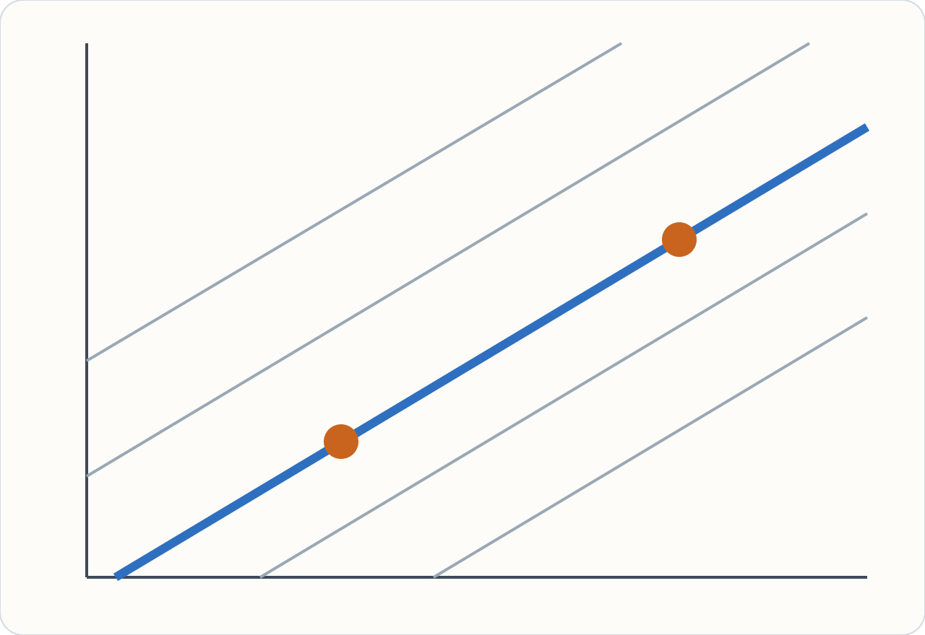
Convex, but with a flat valley floor
Q7 · INTUITION AND MATHS
Anchors only see the gap d₁ − d₂, so the loss is (d₁ − d₂ − y)². Slide along the valley, adding the same amount to both drifts, and the loss never changes.
H = 2·[[1, −1], [−1, 1]]
eigenvalues 4 and 0
0 belongs to direction (1, 1)
Convex: it never curves down, so every minimum is a global one. Not strictly convex: one direction is flat, so the minimum is not unique.
Two batches, one drift each (d₁ across, d₂ up). Grey: equal-loss lines. Blue: the valley floor d₂ = d₁ − y. Both orange points have the lowest loss.
You caught this: the chat first said “strictly convex”, then corrected itself. In the real model the flat direction is “add one constant to every batch’s drift”.
Notes:
H is the Hessian, the matrix of second derivatives, which describes how the loss curves in each direction. For the loss (d₁ − d₂ − y)², the second derivatives are 2, −2, −2, 2. Its eigenvalue 0 goes with the direction (1, 1): moving both drifts up together. In the full model the same flat direction exists with 205 unknowns: add a constant s to every c_k. Every anchor miss is unchanged, so A has a null space and AᵀA is singular.

Slide 12
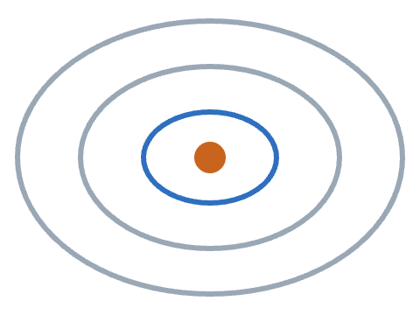
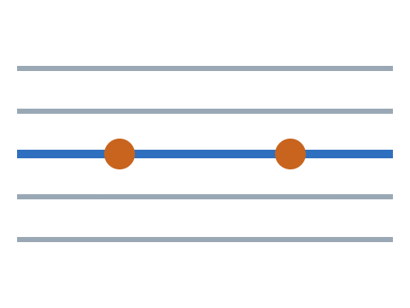
Positive definite means a bowl, not a trough
Q8 · REFRESHER
Positive definite: a bowl
Semi-definite: a trough
xᵀHx > 0 for every x ≠ 0. All eigenvalues > 0. One lowest point.
xᵀHx ≥ 0, and = 0 along some x. An eigenvalue is 0. A whole line of lowest points.
Back to the toy. Add a gauge term γ·d₁² (“pin batch 1’s drift near 0”):
½ xᵀHx = (x₁ − x₂)² + γ·x₁²
= 0 only if x₁ = x₂ and x₁ = 0, so only at x = 0 → a bowl
x is any direction you could step in; xᵀHx is how sharply the loss curves that way. The code also adds a tiny 10⁻⁸·N_eff to every diagonal entry.
Notes:
A symmetric matrix H is positive definite when xᵀHx is positive for every non-zero x. That is the same as all its eigenvalues being positive. Semi-definite allows zero, which is a flat direction. In the toy, the first term is zero along the valley (x₁ = x₂), and the gauge term is zero only when x₁ = 0. Both are zero together only at x = 0, so the trough has become a bowl with one lowest point.

Slide 13
The gauge nails the clock to the ground
Q9 · INTUITION
Measured
gap 2
gap 3
All slide +2
gap 2
gap 3
Anchors measure only the gaps between batches, like timing runners only against each other. Move everyone 2 forward and every gap is the same, so the data cannot say where zero is. The gauge adds that one missing rule.
Reference gauge (the paper’s default)
Mean gauge
One batch is zero: L θ_r = 0. Its clock is the shared clock. Here r = sep2015, the batch with the most anchors.
The drifts add to zero at every knot: Σₖ L θₖ = 0. The shared clock is the batches’ average.
Added as a strong penalty γ‖Gθ‖² with γ = 10³·N_eff/Q, so the rule holds almost exactly. Paper Eq. (4).
Notes:
Three batches are drawn as runners on a track. The top row is one possible answer; the bottom row moves all three forward by 2. The gaps, which are all the anchors can measure, are identical. Without a gauge the solver has no reason to prefer one row over the other. Each gauge is a choice of convention, not a fact about the data.

Slide 14
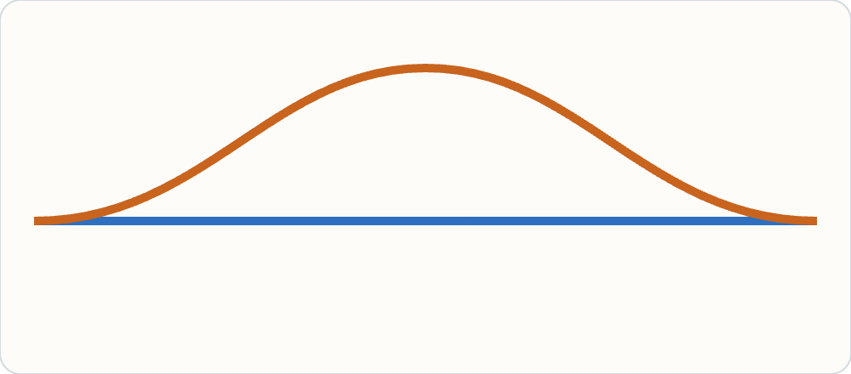
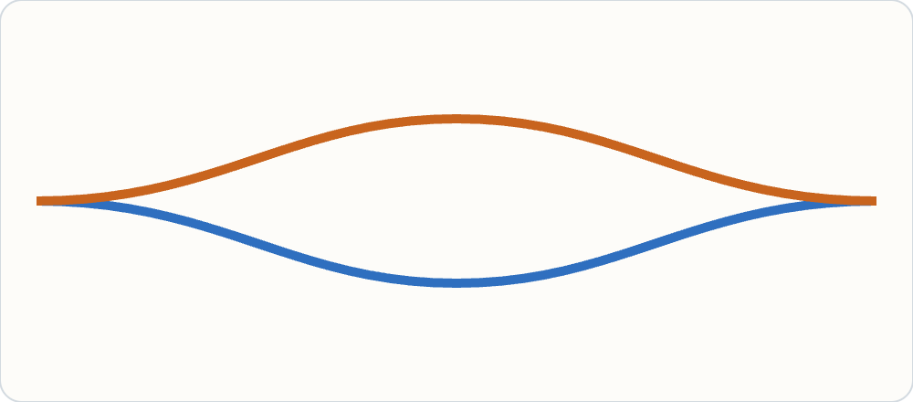
Gauges differ in the clock’s shape, not its shift
Q9 · MATHS · A CORRECTION
A constant shift changes nothing
A common bend does matter
Add s to every drift: misses unchanged, second differences of a constant are 0, and c has no bound. Penalty and bounds are untouched too.
Each gauge pins a whole curve (41 knot values). Bending the clock, fₖ → h ∘ fₖ for every k, leaves every map the same but changes each warp’s wiggle.
Same gap e between the batches, so nearly the same map. Smoothness penalty:
ref: ‖D₂e‖²
mean: 2·‖D₂e/2‖² = ½‖D₂e‖²
Reference: d₁ = 0 (blue), d₂ = e (orange)
Mean: d₁ = −e/2, d₂ = +e/2
So one λ smooths the same relative drift half as hard under the mean gauge in this two-batch toy. That is how the gauge interacts with the smoothness penalty.
The chat said changing the gauge “shifts” the clock and so changes the penalty. A shift cannot; a bend can. The toy is a first-order sketch, not a result from the paper.
Notes:
The paper’s sentence: a common monotone reparameterisation f_k ↦ h ∘ f_k leaves every map g_k→l unchanged, but the penalty and bounds are not invariant to it, so gauges can give slightly different maps. The two-batch toy treats the map as roughly t plus the gap between the drifts, which holds when drifts change slowly. Under the reference gauge the whole curve sits in one warp; under the mean gauge it is split in two halves, and squaring halves gives a quarter each, so a half in total.

Slide 15
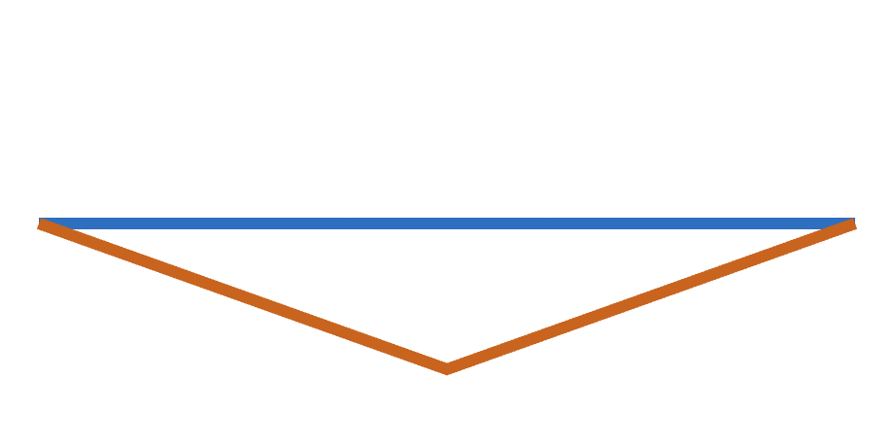
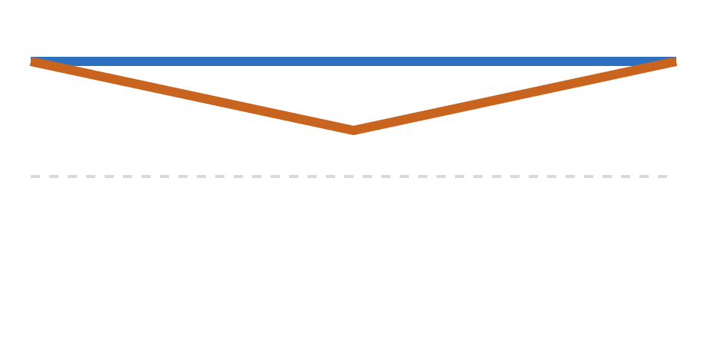
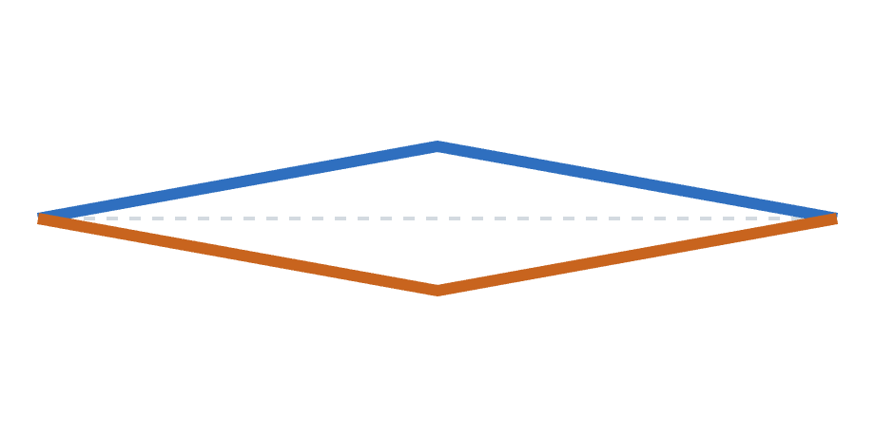
Slide the ruler or stretch it: same maps, different bends
Q9 · WORKED EXAMPLE: SHIFT VS SHAPE
Two batches. Compounds at 10, 20, 30 in A sit at 10, 23, 30 in B: a bump of 3 in the middle. Plot each batch’s drift at those three compounds (clock time minus its own time) under three choices of clock.
Reference: clock = A
Shift: clock = A + 5
Shape: clock = average
A: 0, 0, 0 · B: 0, −3, 0
Bends: 0 and 3 · penalty 0² + 3² = 9
A: 5, 5, 5 · B: 5, 2, 5
Bends: 0 and 3 · penalty 9 (unchanged)
A: 0, +1.5, 0 · B: 0, −1.5, 0
Bends: 1.5 and 1.5 · penalty 4.5
In all three, A’s 20 and B’s 23 land on the same clock point, so the map A → B is identical. Sliding the clock moves every curve together and bends nothing. Re-shaping it moves bend from one warp to the other, and the penalty sees that.
Blue: batch A. Orange: batch B. Grey dashed: zero drift. “Bend” here is the bump height at the middle knot; the real penalty squares second differences, which behaves the same way.
Notes:
Think of the shared clock as a rubber ruler laid beside every batch. Sliding the ruler (a shift) moves all the marks equally: every batch’s offset changes by the same amount, and no curve gets more or less bent. Stretching the ruler unevenly (a change of shape) changes where the marks fall: a warp that was straight against the old ruler becomes bent against the new one, and vice versa. The maps between batches only ask which marks line up across batches, so they do not care about either. The smoothness penalty asks how bent each warp is against the ruler, so it cares about the stretch but not the slide. The reference gauge says “the ruler is batch A’s own clock”, which puts all the bend into B. The mean gauge says “the ruler is the average of the batches”, which splits it. With the same λ, the split version pays half the penalty for the same relative bump.

Slide 16
No gauge is correct, and the paper leaves it open
Q9 · EVIDENCE
At λ = 10 | Reference | Mean
Held-out anchor error (lower is better) | 0.111 min | 0.096 min
TIC correlation, drifted pairs | 0.598 | 0.595
TIC correlation, near-aligned pairs | 0.779 | 0.768
A trade-off: the mean gauge predicts held-out anchors better; the reference gauge gives slightly higher TIC correlation.
You said: no mathematically correct gauge
But it was not chosen by experiment
Right. The data cannot pick one, so the choice is a convention.
The selection rule fixes the reference gauge and tunes only λ. This table compares; it did not select. The paper calls the choice “not settled”.
Your idea that a different penalty might favour the mean gauge fits the previous slide, but it has not been tested. Paper: sensitivity results.
Notes:
Numbers from the paper’s sensitivity results. The chat’s explanation that the mean gauge “distributes the warping responsibility evenly” is a plausible story but the paper does not test it. A fuller comparison would tune λ separately for each gauge; the paper’s rule tunes λ for the reference gauge only.

Slide 17

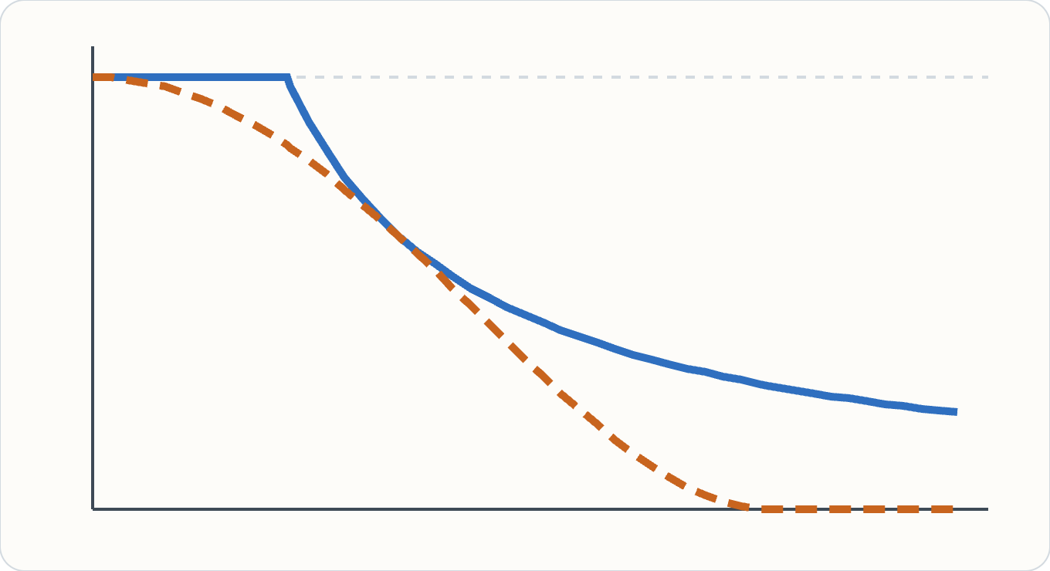
Eight solves: plain, then Huber, then Tukey
Q10 · INTUITION AND MATHS
1 plain solve
every weight 1
3 Huber-weighted solves
shrink big misses
4 Tukey-weighted solves
drop gross mismatches
σ̂ = max(1.4826·MAD(r), 0.25 bins)
Huber: w = min(1, c/|r|), c = 1.345σ̂
Tukey: w = (1 − (r/c)²)², c = 4.685σ̂
w = 0 when |r| ≥ c
Huber’s loss is convex, so it starts safely. Tukey’s is not: begun from a poor fit it could throw away good anchors. Hence Huber first.
Weight (up, 0 to 1) against miss size |r|/σ̂ (across, 0 to 6). Blue solid: Huber. Orange dashed: Tukey, exactly 0 beyond 4.685.
Fixed schedule, not “until θ stops changing”. Each solve has one answer; the robust fit as a whole is not convex, so its answer depends on the start. 3.9% of fish anchors end at weight 0.
Notes:
Your summary was right apart from naming Huber twice: the second stage is Tukey’s bisquare. Two corrections to the chat. First, Huber’s loss is convex but not strictly convex: beyond the threshold it grows in a straight line. Second, the loop does not run to convergence; the code runs one unweighted solve, three Huber-weighted solves and four Tukey-weighted solves. Each solve is a weighted bounded least-squares problem with a unique answer, thanks to the gauge and smoothness terms. MAD is the median absolute deviation; 1.4826 × MAD estimates the standard deviation for Gaussian data while ignoring outliers.

Slide 18
IRLS weighs rows; Adam scales columns
Q11 · INTUITION
IRLS: one weight per anchor (row)
Adam: one step size per parameter (column)
“How much do I trust this data point?” Pale row: down-weighted. Dashed row: weight 0, a rejected mismatch. All unknowns are then solved together, exactly.
“How far should I move this unknown?” Every data point counts fully; each parameter takes its own gradient step.
A closer analogy from machine learning: per-sample loss weighting, as in robust regression or down-weighting noisy labels.
Notes:
You asked whether IRLS is like Adam giving each weight its own learning rate. The shared idea is adaptive re-scaling from the latest errors. The difference is what gets re-scaled: IRLS re-scales the rows of A (data points), Adam re-scales the steps along each column (parameters). IRLS also needs no step size: each round is a complete least-squares solve.

Slide 19
Hold out stretches of time, not samples
Q12 · INTUITION AND MATHS
0
1
2
3
4
0
1
2
3
4
0
1
2
3
4
0
1
The 0–45 min run as 17 blocks of 12 bins (2.7 min); block b goes to fold b mod 5. Orange: fold 2, held out across every sample and batch.
Folds over samples leak
Folds over time do not
Hide one sample and its compounds still have anchors at the same times in other samples. The test never visits the gaps between compounds, where a wiggly warp goes wrong.
An anchor is tested if either end lies in the fold, trained on only if neither does. The warp must bridge a 2.7-min hole, so wiggles show up as error.
Pick λ from {0.1, 1, 10, …, 10⁴} by the lowest median held-out error: λ = 10, error 0.111 min.
Your explanation of the leak is right. The TIC correlation is never used to choose λ; after selection it stays between 0.595 and 0.600 for every λ from 1 to 10⁴.
Notes:
So cross-validation is used to pick λ, just not ordinary cross-validation. The full grid is 0.1, 1, 10, 30, 100, 300, 1000, 3000 and 10,000. 200 bins divided into blocks of 12 gives 16 full blocks and one of 8. This is the same idea as spatially or temporally blocked cross-validation in machine learning, used when nearby points share information.

Slide 20
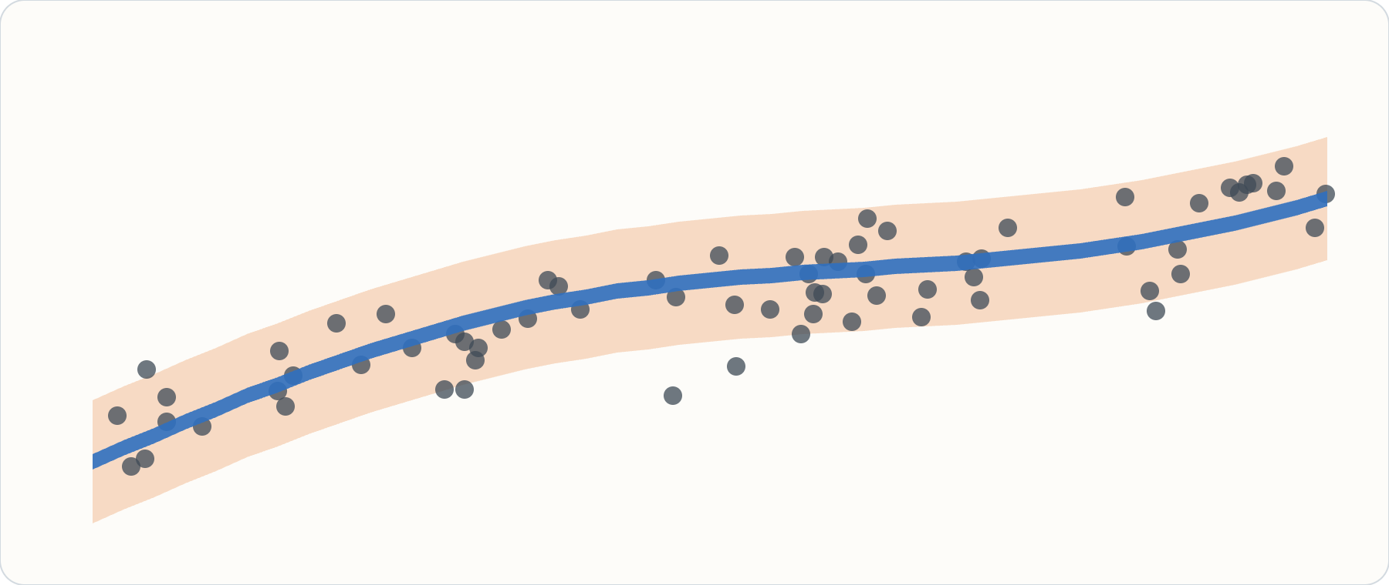
A thin thread for the line, a corridor for a peak
Q13 · INTUITION
Band: where is the line?
Refit 200 times on resampled samples. Thousands of anchors pin it: 0.044–0.054 min wide. Holds 15% of held-out anchors.
Interval: where will a peak be?
Adds each peak’s own scatter. Meant to hold 90%; holds 81%. A chemist’s search window in batch l.
Sketch, not data. Dots: held-out anchors. Blue: the band for the map itself. Orange: the predictive interval for one compound.
You recalled the bands being insensitive to smoothness. The paper’s finding is different: bands widen only weakly where direct anchors are sparse (Spearman ρ = −0.40).
Notes:
The band answers “how sure are we about the average map?” The interval answers “where should I look for this compound in the other batch?” A well-pinned line with scattered points gives a thin band and a wide interval, which is what the fish data show. The 15% is expected to be low: the band was never meant to contain individual peaks.

Slide 21
Why a 90% interval catches only 81%
Q13 · MATHS
1 · Resample samples
2 · Band, then interval
In each batch, draw samples with replacement; sample i appears mₖ,ᵢ times. An anchor between two samples gets weight mₖ,ᵢ · mₗ,ᵢ′ (0 if either is missing). Refit. Repeat 200 times.
The 5th–95th percentiles of the 200 maps give the band, half-width h. Add the pair’s anchor scatter σₖₗ:
half-width = √(h² + (1.645·σₖₗ)²)
3 · The likely gap: bias
4 · The fix: calibrate
The smoothness penalty pulls every refit toward a smoother curve. Resampling shows how much the fits vary, not how far they are all pulled. The paper calls this “one likely reason”; it is not tested.
Widen the intervals until held-out anchors are covered at the stated rate, for example by conformal scaling. The paper recommends this before anyone relies on them.
1.645 is where a normal distribution leaves 5% in each tail, so ±1.645σ holds 90% if the scatter is Gaussian. Paper: uncertainty results; trust-align plans to test the calibration.
Notes:
Adding the two widths “in quadrature” (square root of the sum of squares) treats the line’s uncertainty and the peak’s scatter as independent. σ_kl is a robust spread of the anchor misses for batch pair k, l, computed from the anchors that kept a positive weight. Smoothing bias is a hypothesis in the paper, not a measured cause; the Gaussian assumption behind 1.645 is another place the interval could fall short.

Slide 22
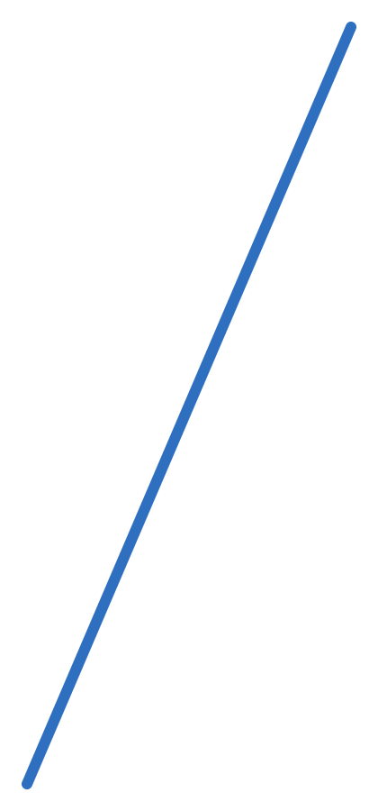
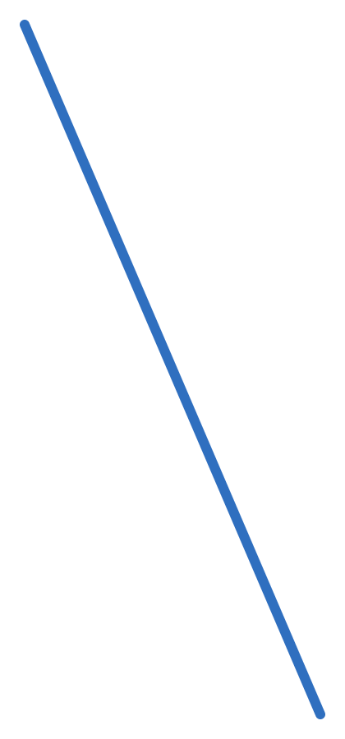
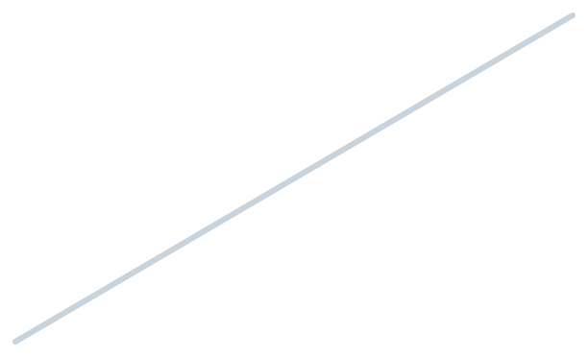
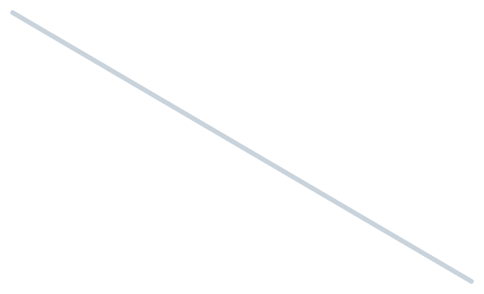
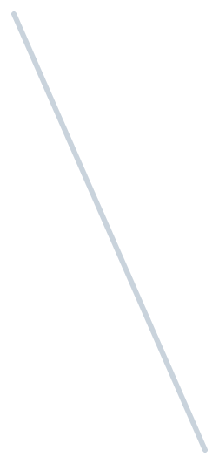
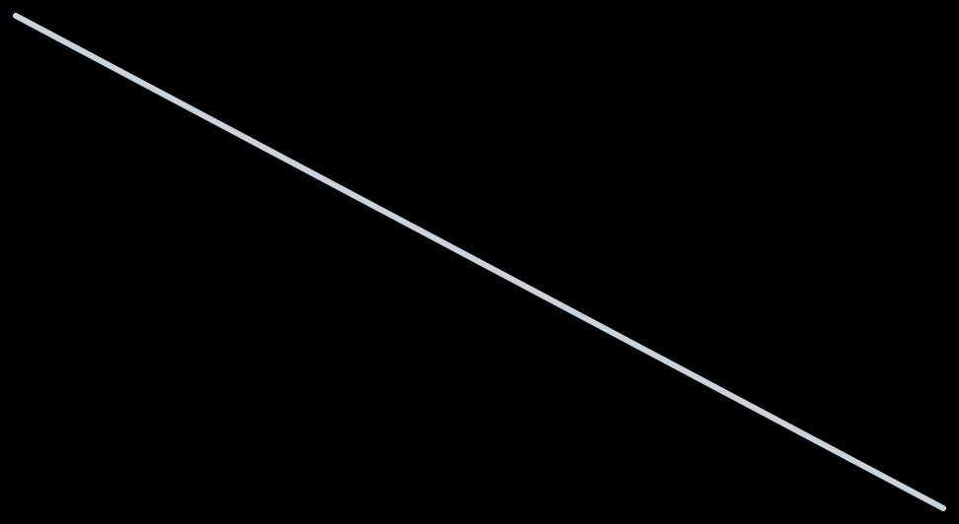
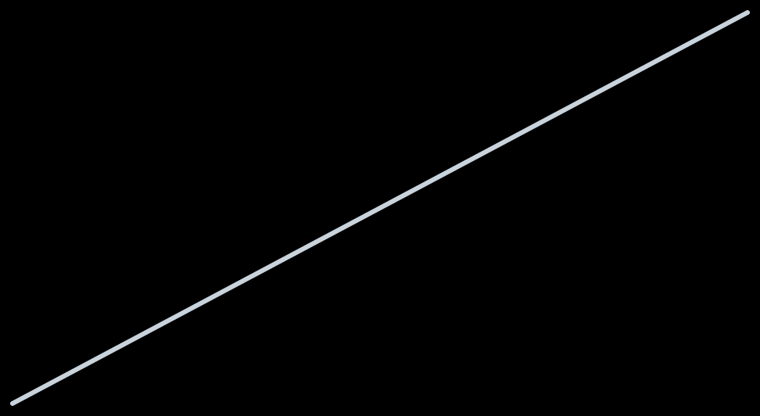

A weak link is held in place by the rest of the web
Q14 · INTUITION AND EVIDENCE
sep2015
aug2015 has two samples, so the aug2015–jul2016 link is thin (orange). But both batches are tied to the clock through every other batch (blue: via sep2015). Neither can move without breaking those ties.
jan2016
apr2016
TIC correlation on that pair: pairwise 0.536, joint 0.598.
Delete a pair’s own anchors and refit: changes ≤ 0.007 on 9 of 10 pairs; sep2015 × jan2016 drops 0.813 → 0.755.
aug2015
jul2016
228 anchors
Caveat: using only each batch’s anchors against sep2015 (a star) stays within 0.016 of the full joint fit on pairs without sep2015. Much of the gain needs just one well-anchored reference.
Notes:
“Imputes the missing map through the network of partial constraints” means: the map between two batches is never fitted on its own. Each batch’s warp onto the clock is fixed by all its anchors with every batch, and the map is then f_l inverse composed with f_k. The chat said deleting a pair’s anchors gives “virtually zero shift”; that holds for nine pairs, not the tenth. The chat also invented anchor counts for the bridges; the slide shows only the 228 reported in the paper.

Slide 23
Where the chat answers were wrong: the fit
CORRECTIONS · 1 OF 2
The chat said | What holds
‖Aθ − y‖² is strictly convex | Convex only: flat along “add one constant to every drift”. The gauge (and a tiny ridge) make each solve unique.
Huber’s loss is strictly convex | Convex, not strictly: past the threshold it is a straight line.
IRLS repeats until θ stops changing | A fixed schedule: 1 plain, 3 Huber and 4 Tukey solves.
With the gauge there is only one solution (your summary) | Each solve has one. The Tukey stage is not convex, so the final answer depends on where Huber leaves it.
Checked against the paper’s Method section and fit_joint in src/multibatch.py.
Notes:
None of these change the method or its results; they change how it should be described. The first was corrected by the chat itself after you questioned it.

Slide 24
Where the chat answers were wrong: the results
CORRECTIONS · 2 OF 2
The chat said | What holds
A new gauge shifts the clock, which changes the penalty | A shift changes nothing. Gauges differ in the shape they give the clock, which the penalty does see.
The reference gauge was chosen from the benchmark | It was fixed by the selection rule; the comparison is a trade-off and the paper leaves it open.
Deleting a pair’s anchors gives virtually zero shift | ≤ 0.007 on 9 of 10 pairs; sep2015 × jan2016 fell from 0.813 to 0.755.
Intervals under-cover because of smoothing bias | The paper’s “likely reason”, not a tested cause.
Checked against the paper’s results and discussion. The numbers the chat quoted (0.116, 0.277, 0.0023, 81%, 15%, λ = 10) all match the paper.
Notes:
The chat also described the mean gauge as “distributing warping responsibility evenly” and gave anchor counts for the borrowing example that the paper does not report. Treat both as illustration, not findings.

Slide 25
Six ideas, each answering one of your questions
THE WHOLE METHOD
1 · One clock
2 · Linear misses
3 · A box
One warp per batch; maps go via the clock, so every path agrees.
Warp forward, hat basis, increments: each anchor is one row of A.
Slope in [0.5, 2] becomes bounds on each δ: bounded least squares.
4 · A gauge
5 · Robust, then tuned
6 · Honest uncertainty
Pins the clock so each solve has one answer; its choice is open.
Huber then Tukey weights; λ = 10 from time-blocked folds.
Bootstrap bands and intervals: 81% for 90%, so calibrate first.
Borrowing strength comes free from idea 1: a thin pair is held by every path through the other batches.
Notes:
A one-slide recap to come back to. Each card points back to a group of questions: 1 to Q1 and Q14, 2 to Q2–Q4, 3 to Q5–Q6, 4 to Q7–Q9, 5 to Q10–Q12, 6 to Q13.

